Slide 1
FORENSIC DENTAL X-RAY IMAGE ENHANCEMENT USING CLAHE AND FAG TO DETERMINE AGE
DOMAIN: DEEP LEARNING
GUIDE: MRS P DEEPA
MEMBERS: KAVYA VR
DAHLIA RANE P
NANDHINI S

Slide 2
SYSTEM ARCHITECTURE

Slide 3
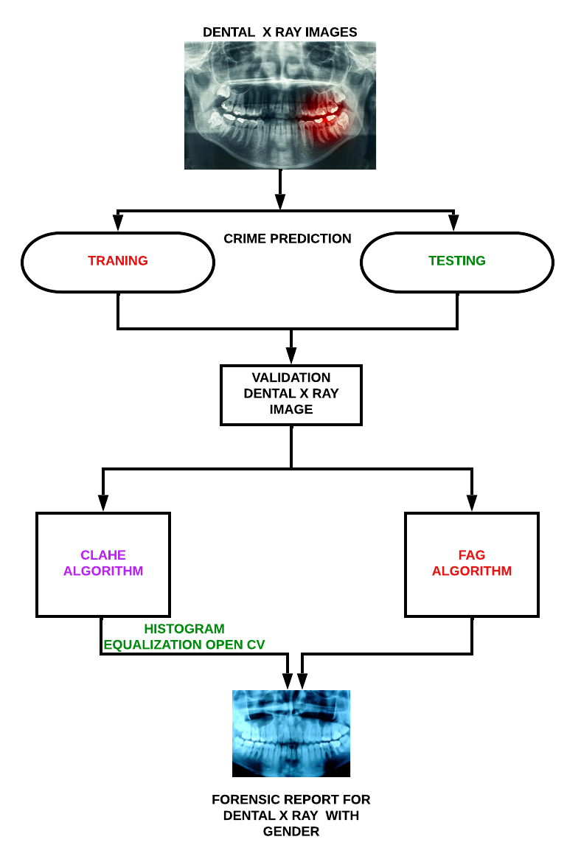

Slide 4
SYSTEM DESIGN

Slide 5
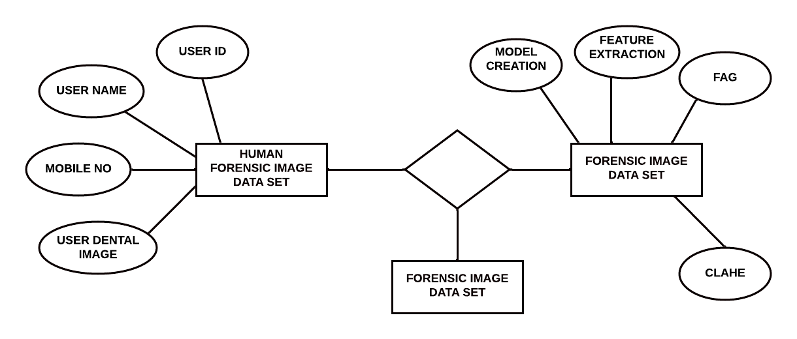
E-R DIAGRAM

Slide 6
UML DIAGRAM

Slide 7
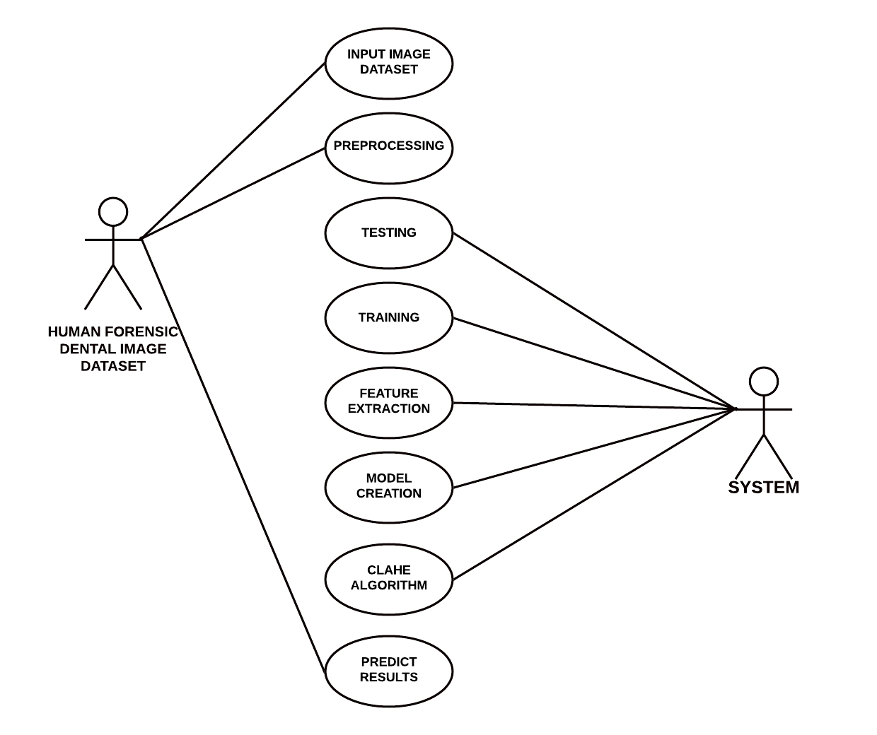
USE CASE:

Slide 8
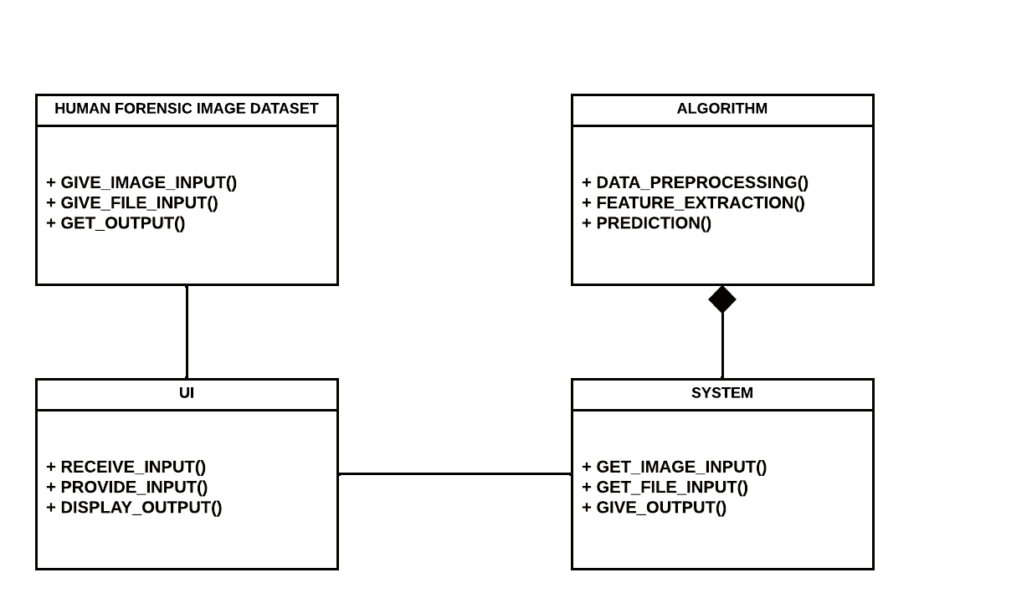
CLASS DIAGRAM:

Slide 9
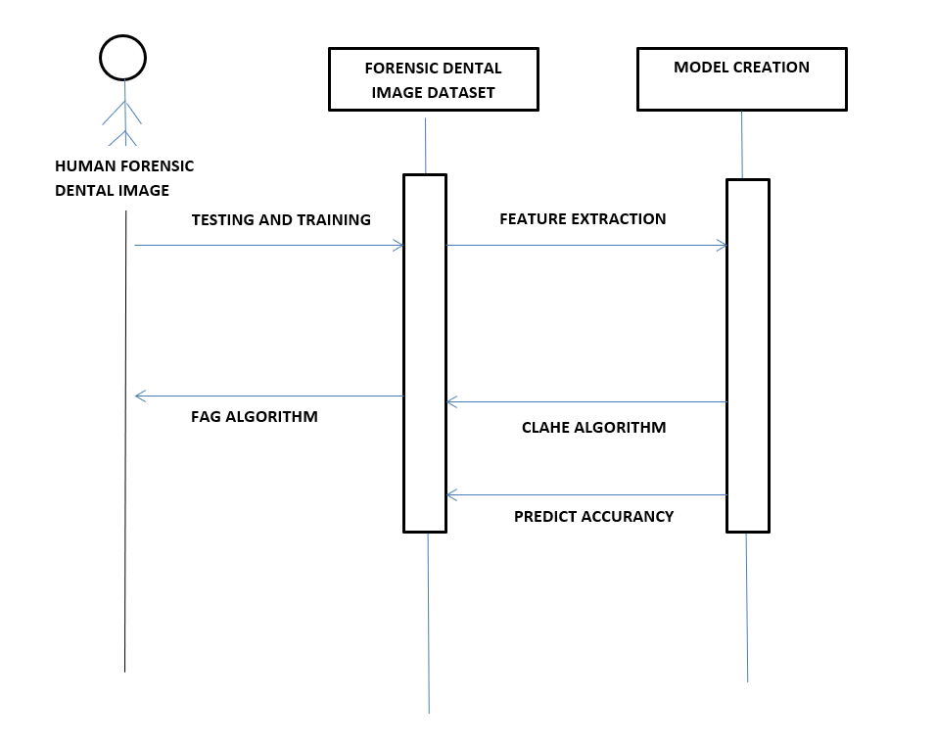
SEQUENCE DIAGRAM:

Slide 10
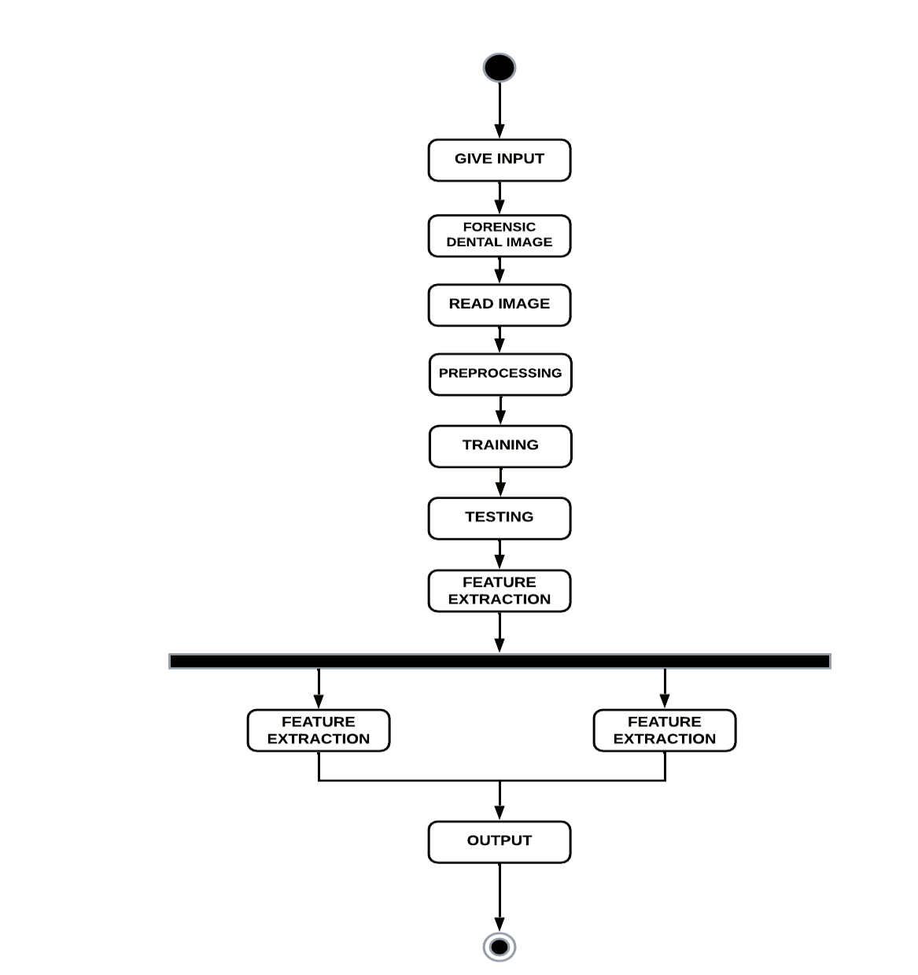
ACTIVITY DIAGRAM:

Slide 11
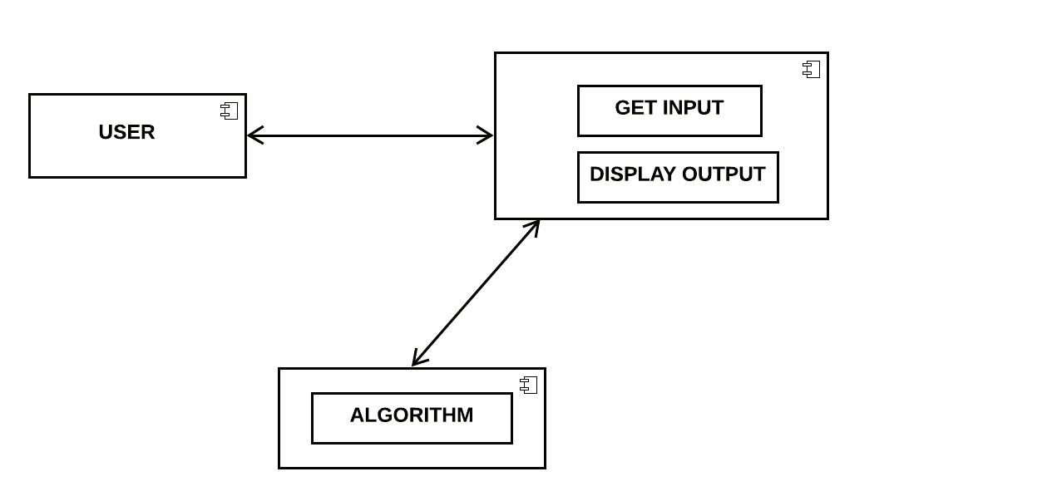
COMPONENT DIAGRAM:

Slide 12
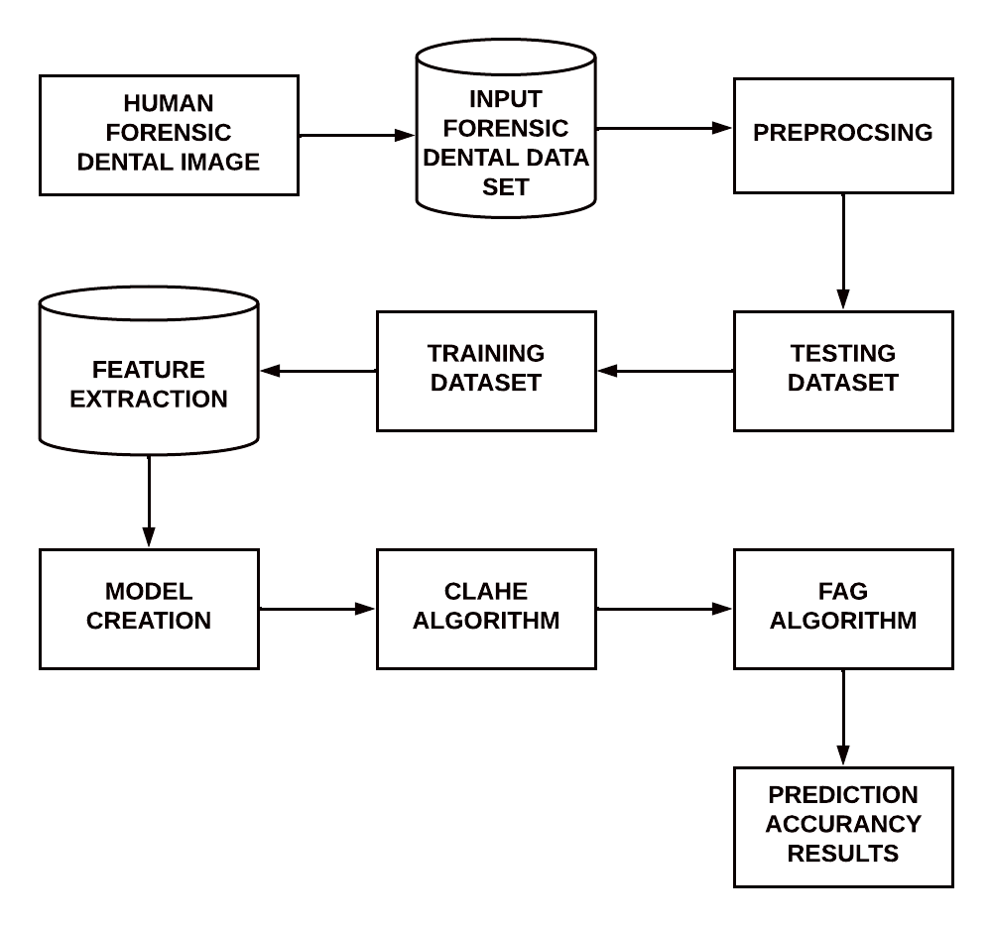
DATA FLOW DIAGRAM:

Slide 13
1. DATA GENERATION USING BALANCING IMAGE
2. FORENSIC FREQUENCY PREDICTION BY CLAHE
3. FORENSIC FREQUENCY PREDICTION USING DENTAL IMAGE
4. LATENT PART LOCALIZATION
5. CONTRASTIVE LEARNING WITH DSA
MODULES, DESIGN AND SPECIFICATION LIST OF MODULES

Slide 14
DATA GENERATION USING BALANCING IMAGE
A police-department demand for the preparation of this rhetorical prediction model is that it forecast residential felony over area and time. consequently, the model classifies burglaries monthly across a regular dental image. The dental image divides town into checkerboard-like cells. At intervals every cell, information is aggregate into dental rhetorical prediction. Every cell is inhabited on a monthly basis. The space is over one-quarter mile square. In each cases, every monthly information set may be a matrixes of six antecedently mentioned classes. The finer resolutions permits the dental image to be interrogated with lot of elaborate eye toward the spatial data inherent within the dataset. Conversely, the lower resolution has the impact of generalizing the spatial data. It ought to be noted that although this will increase the score of dental image classification, the general accuracy of the prediction is diminished attributable to the ensuing misclassification of cold spots. We have tendency to settle for the trade off on accuracy to own a better score on hotspots because the local department clearly encompasses a larger unconditional interest in knowing that a locality are a hotspot.

Slide 15
FORENSIC FREQUENCY PREDICTION USING DENTAL IMAGE
The only difference is the addition of the dental Forensic prediction attribute; an instance represents the frequency of Forensic in a particular month, for a particular FAG algorithm and postcode, and for a particular Forensic type. To find the correspondence between FAG algorithm and postcodes, the Office for National Statistics was used, which has a databases of dental images listing postcodes and their different output areas, including FAG algorithm. This dental image database is from 2011. The lower number of data objects in this dataset compared with the FAG algorithm is due to the information on the equivalence between the CLAHE and FAG algorithm. Generally, postcodes areas cover several FAG algorithms, thus capturing information at a different geographical level which could potentially improve predictions. In terms of the performance of the algorithm CLAHE and FAG algorithm have medium correlation coefficients, while the M5P algorithm has a strong correlation coefficient between the values predicted by the model and the real values.

Slide 16
LATENT PART LOCALIZATION
Dental image rhetorical prediction elements square measure vital personally rhetorical. The explored rigid body elements to develop strong options. However, because of the dissatisfactory pedestrian detection algorithms and huge dental variations, the tactics of exploitation rigid body elements for native feature learning isn't the best answer. once exploitation rigid body elements, the highest half consists of enormous quantity of background. This motivates United States to be told and localize the pedestrian elements mechanically. we have a tendency to integrate CLAHE and FAG formula because the half localization internet in our projected model. The initial CLAHE is projected to expressly learn the image transformations parameters, like translation and scale. it's two main advantages: (1) it's absolutely differentiable will|and may|and might} be simply integrated into existing deep learning frameworks (2) it can learn to translate, scale and crop or warp a noteworthy regions while not to express region annotation. These facts create it terribly appropriate for pedestrian elements localization.

Slide 17
FORENSIC FREQUENCY PREDICTION BY CLAHE
This experiment investigates the prediction of Forensic frequency by CLAHE algorithm. The procedure used in the experiment, outlining the four middle steps of the CLAHE algorithm methodology data understanding, data preparation, modeling and evaluation. The first stage in the Data Understanding step was to integrate the data into one dataset by aggregating the monthly files. All experiments started with this dataset. For the purpose of this experiment, the frequency per month, per CLAHE algorithm, for each Forensic type was computed an instance represents the frequency of Forensic for a particular month, CLAHE algorithm and Forensic type. This aggregation meant that some of the attributes that were relevant for individual Forensic became irrelevant for a monthly record of Forensic frequency. These attributes are: Forensic ID, age, father name, Forensic details in the dataset for this experiment included attributes: The instances from the original dataset that had missing values for CLAHE algorithm name were excluded.

Slide 18
CONTRASTIVE LEARNING WITH DSA
We hand out FoID by 1st describing its building elements then the multi-task learning strategy. FoID maps every scan instances into associate degree embedding. Given a question instance, we tend to calculate the similarities between the question and every one the gallery instances within the embedding house and come back the graded retrieval list. to attain effective illustration learning, augmentations that cowl the potential anatomical variations as in clinics is that the key. The planned DSA consists four kinds of parameters impressed by rhetorical observations, and is severally applied to every attention patch on the fly.
(i) Random tooth reduction that aims to simulate tooth loss caused by injury or inventions
(ii) Random physical object addition that adds patches of versatile shapes to crown or tooth regions such augmentation aims to simulate the common artifacts of dental filling, implant, and brace.
(iii) Random rigid patch rework at intervals a spread of angles and displacements. The augmentation not solely enforces read comparison as within the commonplace instance discrimination learning, however conjointly simulates world teeth arrangement changes, since the rework is performed for patches severally.
(iv) Random colour disturbance of distinction shifting and Gaussian noise at intervals designed ranges for simulating totally different scanning setup and machine noises. additional details concerning the implementation of DSA area unit enclosed.

Slide 19
ALGORITHM:
1. contrast limited adaptive histogram equalization (CLAHE)
2 fuzzy adaptive gamma (FAG)

Slide 20
Contrast restricted adaptational bar graph leveling (CLAHE)
algorithmic program was used because the initial technique for enhancing the distinction between veins and also the background. The careful step of the CLAHE algorithms square measure explained as follows. Image is rotten into variety of continuous and non-overlapping discourse regions. A bar graph for every of those discourse regions is computed. Clip limit could be a threshold parameter for effectively sterilisation the distinction of the image. Thus, associate degree applicable price of clip limit is set supported trial-and-error to extend the native image regions. The bar graph of every discourse region is clipped on top of the brink. The transformation perform for every clipped bar graph is applied to perform equalize greyscale mapping. The mathematical expression for remodel intensity price into uniform distribution is given as
g = [gmax − gmin] ∗ P(f) + gmin (1)
where gmax is maximum pixel value,
gmax is minimum pixel value,
g is computed pixel value,
P(f) is a cumulative probability distribution.
The neighboring regions are combined using bilinear interpolation to create an enhanced image without artificially induced boundary

Slide 21
fuzzy adaptive gamma (FAG)
The fuzzy reconciling gamma (FAG) algorithmic rule was used because the second technique to boost the distinction between veins and also the background. The planned FAG image sweetening involves 3 stages: fuzzification, modification of membership values, and defuzzification.
Fuzzification: Fuzzification may be a step to see the degree to that computer file belongs to every of the suitable fuzzy sets via the membership operate. Hence, this work involves changing greyscale worths of dorsal hand vein image as AN input to the fuzzy domain whose value ranges between zero and one employing a linear operate. The linear operate is expressed as
Iout = I in − Imin Imax − Imin (2)
where I in is the image of the dorsal hand vein,
I out is the dorsal hand vein image in the fuzzy domain,
Imin is the minimum value of the gray-level and
Imax is the maximum value of the gray level in the image.
Modification of the membership values: Low distinction of hand vein pictures will either be bright or dark intensities. looking on the brightness of the image, completely different image intensities ought to be changed otherwise. Therefore, the fuzzy modification is administered to reinforce image component intensity victimization AGC . consistent with the mean intensity µ, larger or up to zero.5, is assessed as a picture with brighter pixels. Meanwhile, the mean intensity of but zero.5 is assessed as a picture with darker pixels. Defuzzification: The new grey levels of defuzzification are created

